Slide 1

Programming Two (csc7051)
Aidan McGowan
Threads

Slide 2
What are Threads?
Before answering this ..
Multitasking – general term referring to ability to perform more that one task simultaneously.
Multiprocessing – ability to run more than one process at a time. (e.g. running a web browser and a word processer at the same time)
Multithreading – performing multiple functions within the same process. (e.g. running a web browser (a process) and using it to send an email, download a file and upload another at the same time). This would be three threads within one process.

Slide 3
What are Threads?
Primary difference between Multiprocessing and Multithreading is that each process maintains a separate data set, whereas multiple threads can work on the same data set.
Multithreading is very efficient. Less taxing on operating system to maintain multiple threads rather than multiple processes.

Slide 4
Types of Threads in Java
Daemon Threads
  created by the JVM
  Designed to run in background to service User Threads
  e.g. Garbage collector
User Threads
  Created by the user
  e.g. the Main thread, launched in the :
  public static void main(String[] args) method.
  From this method you will launch all other Threads

Slide 5

Creating Threads
Two main ways to do it in Java…
1. Subclass the Thread class
2. Implement the Runnable interface

Slide 6
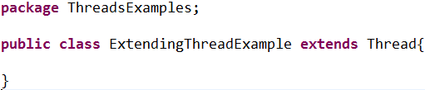
Subclassing the Thread class
Java has a class called Thread. By extending this class you get all it’s functionality.
This class is a valid Thread but does nothing. You need to add a run method.
The JVM expects to find the code intended to be executed as part of the Thread in the run method.

Slide 7
Subclassing the Thread class
The Thread class implements the Runnable interface.
The only method declared in Runnable is Run.
So at this point you need only to Override the Run method to implement your Threaded code.
To start the Thread you call start() not run()
run() method is what is executed by the thread after you call start().

Slide 8
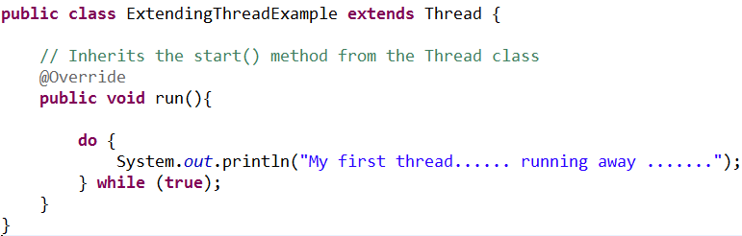
Subclassing the Thread class

Slide 9
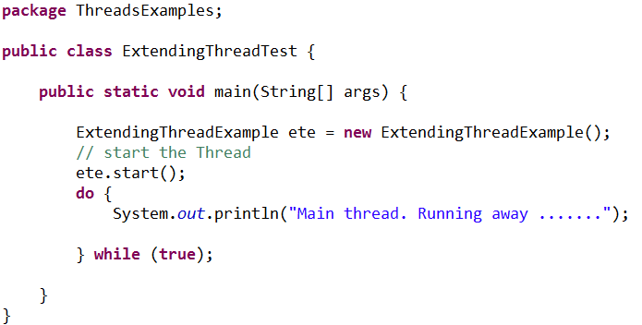
Subclassing the Thread class

Slide 10

Output…
This will vary each time the class runs…

Slide 11
Implementing the Runnable interface
Remember Java supports only single class inheritance.
Extending Thread restricts your class.
Better to implement an Interface…
Bypass the Thread class (which implements the Runnable interface) and implement Runnable yourself.

Slide 12
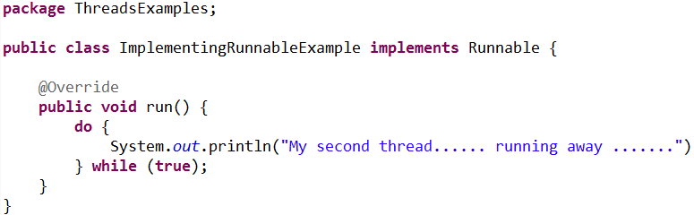
Implementing the Runnable interface

Slide 13
Implementing the Runnable interface
But, you don’t have the start method anymore (that’s part of the Thread class).
Answer – the Thread class takes as an argument in it’s constructor an Object of type Runnable.
By passing your class which has the run method (that implements runnable) to the Thread class you can delegate the Thread class to do some work for you… in this case use it’s start().
(Example of The Delegation Design Pattern in OO)

Slide 14
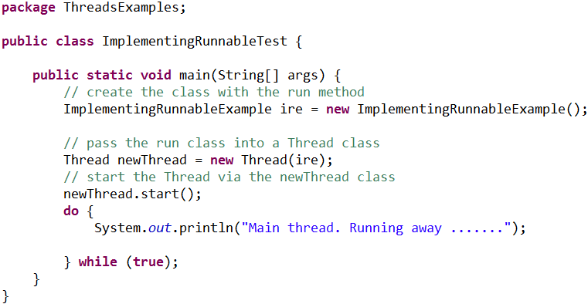
Implementing the Runnable interface

Slide 15

Exercise I
Create a Thread that counts down from 10 to 1 in seconds….
Notes:
public class CountdownController {
public static void main(String[] args) {
CountDownThread countd = new CountDownThread();
Thread t = new Thread(countd);
t.start();
}
}
________________________________________________________________________________________
public class CountDownThread implements Runnable {
@Override
public void run() {
int loop = 10;
do {
System.out.println(loop);
loop--;
try {
Thread.sleep(1000);
} catch (InterruptedException e) {
System.out.println("Interupted");
}
} while (loop > 0);
}
}

Slide 16
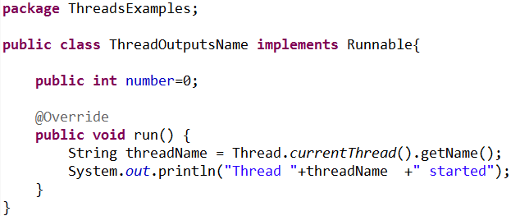
Naming of Threads
When you create a thread you can give it a name. The name can help you distinguish different threads from each other. For instance, if multiple threads write to System.out it can be handy to see which thread wrote the text.

Slide 17
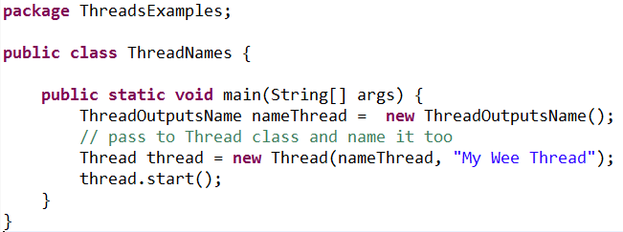
Naming of Threads

Slide 18
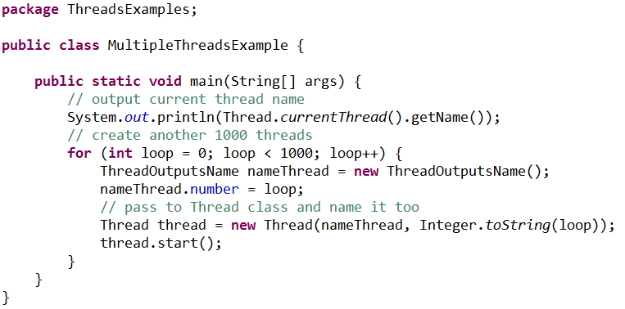
Starting multiple threads

Slide 19
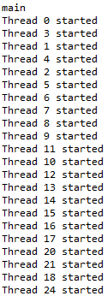
Starting multiple threads
Note that even if the threads are started in sequence (0,1, 2, 3 etc.) they may not execute sequentially, meaning thread 0 may not be the first thread to write its name to System.out.
This is because the threads are in principle executing in parallel and not sequentially.
The JVM and/or operating system determines the order in which the threads are executed.
This order does not have to be the same order in which they were started.

Slide 20
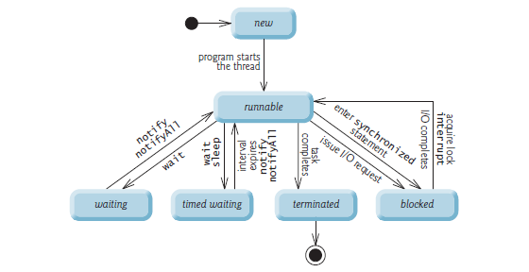
Thread states
At any time, a thread is said to be in one of several thread states.
Java hides most of this detail from you, greatly simplifying the task of developing multithreaded applications

Slide 21
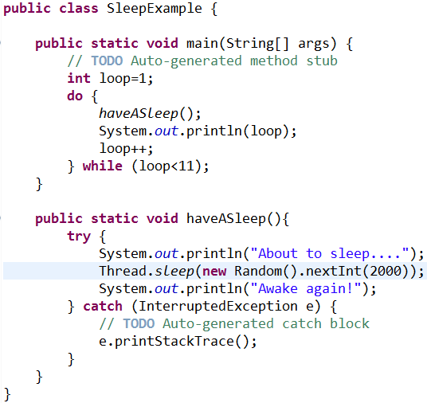
Thread sleep
Causes the current thread to suspend execution for a specified period.
This is an efficient means of making processor time available to the other threads of an application or other applications that might be running on a computer system.
The sleep method can also be used for pacing

Slide 22
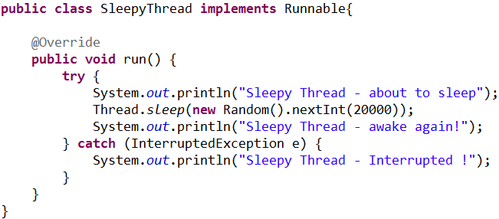
Thread interrupt
An interrupt is an indication to a thread that it should stop what it is doing and do something else. It is up to the programmer to decide exactly how a thread responds to an interrupt, but it is very common for the thread to terminate.
A thread sends an interrupt by invoking interrupt on the Thread object for the thread to be interrupted

Slide 23
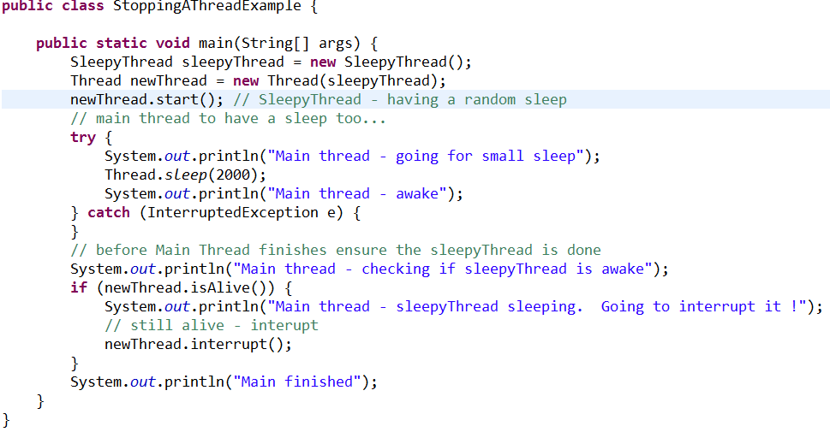
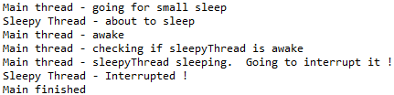
Thread Interrupt

Slide 24
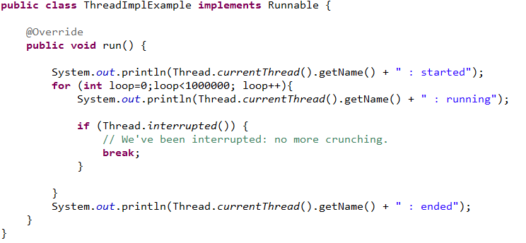
Thread Interrupt
Checking if the Thread has been Interrupted and taking appropriate action

Slide 25
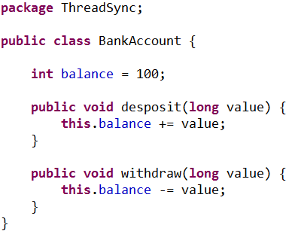
Sharing a resource – a problem for Threads
Two threads that access the same object. For example a Bank Account class.

Slide 26
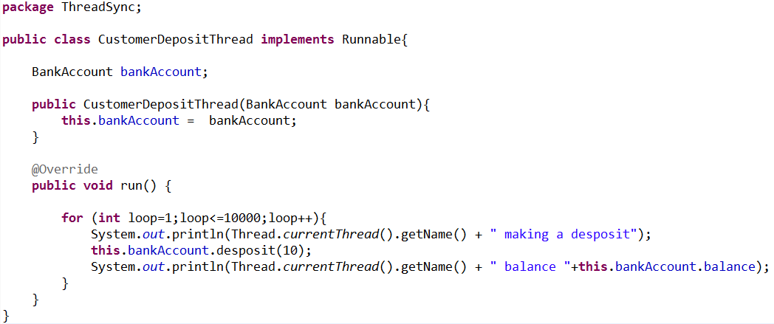
Threaded class that deposits into the Bank Account

Slide 27
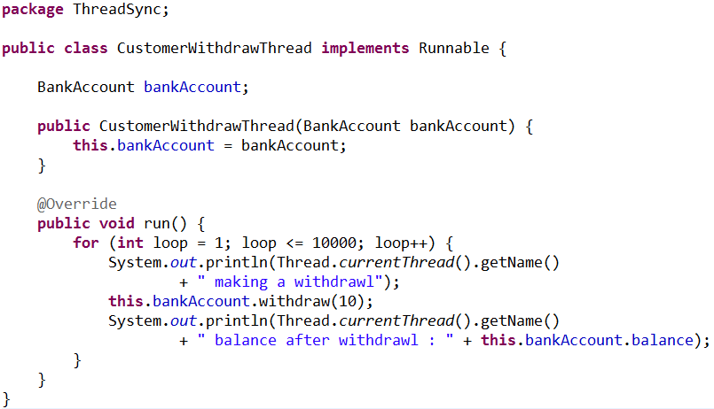
Threaded class that Withdraws from the Bank Account

Slide 28
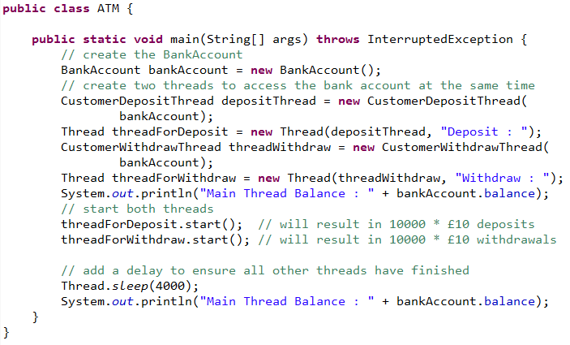
ATM class
This class starts the deposit and withdraw threads. But both threads access the same bank account object.

Slide 29
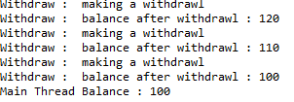

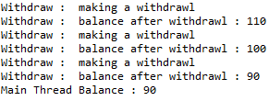
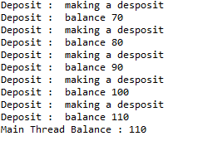
Syncing a Thread
Program run – inconsistent results…

Slide 30
Race Conditions & Critical Sections
The situation where two threads compete for the same resource, where the sequence in which the resource is accessed is significant, is called race condition. A code section that leads to race conditions is called a critical section.
In the previous example the method deposit() and withdraw() are critical sections, leading to race conditions.
Race conditions can be avoided by proper thread synchronization in critical sections.

Slide 31
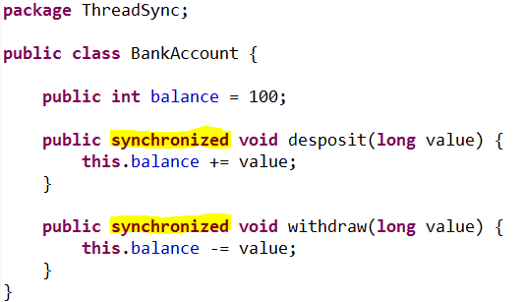
Race Conditions & Critical Sections
A Java synchronized block marks a method or a block of code as synchronized. Java synchronized blocks can be used to avoid race conditions.

